Slide 1
Lesson 2:
Generative AI and Prompt Crafting

Slide 2
Brainstorming
Are you familiar with generative AI tools like ChatGPT? Have you used any? How?
How do you think that AI tools learn information?

Slide 3
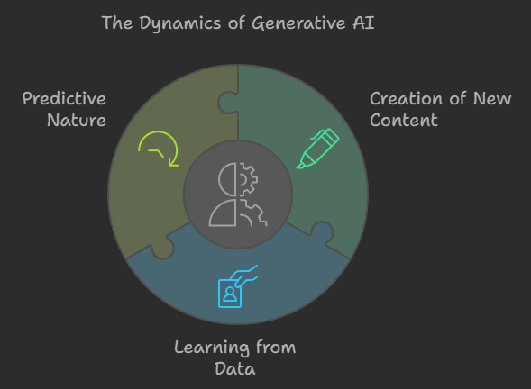
What Is Generative AI?

Slide 4
Key Concepts
  AI: Computers perform tasks that typically require human intelligence, e.g., understanding language, recognizing images.
  Generative AI: A type of AI that creates new content by predicting the next part of a sequence based on its training data.
Language Models: These models, like ChatGPT, are trained on vast amounts of data (books, websites, etc.) to predict and generate text responses.

Slide 5
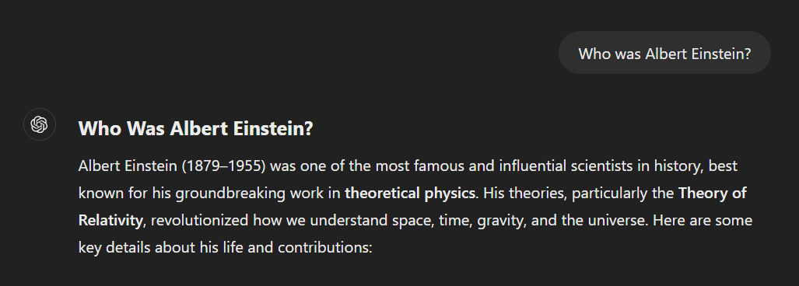
An example of ChatGPT Use

Slide 6
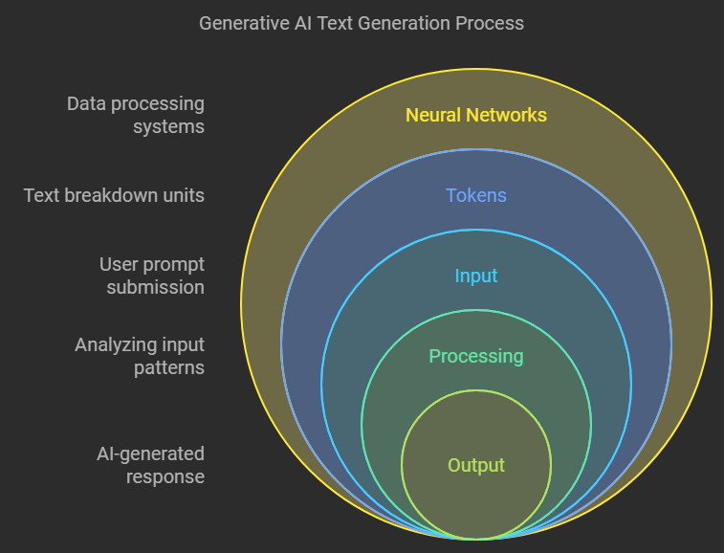
How does Generative AI work?

Slide 7
Key Concepts
  Tokens: How words and phrases are broken down into smaller chunks that the AI understands.
  Neural Networks: The system used by AI to process data and generate text.
Training Data: The large datasets the AI uses to learn how to respond to different types of input.

Slide 8
Crafting Good Prompts
  Help AI understand exactly what you want.
  The more detail you give, the better the AI responds.
Provide context to help AI understand the type of response you want, e.g. formal, casual, concise.
Phrase your question accordingly.

Slide 9
Ethical Considerations
  Plagiarism: Is using AI for schoolwork cheating? When is it okay to use AI as a student?
  Bias: AI can reflect biases in the data it’s trained on. How can we ensure fairness in AI-generated content?
  Impact on Society: What are the positive / negative impacts of AI?
  Limitations: AI is not perfect. It can provide incorrect / misleading information.

